Slide 1

E L E C T R I C

Slide 2
E L E C T R I C
What is your opinion on current gun regulations?
need stronger regulation of all firearms.
need stronger regulation of assault weapons only.
do not need to change regulations
need fewer regulations of firearms
no opinion
Importance to You:
not important
very important
What is your zip code?
94305

Slide 3
E L E C T R I C
Here are candidates that agree with you most
Elizabeth Warren - President
Agrees with you on: education, environment
Disagrees with you on: healthcare, taxation
FOLLOW
Kamala Harris - Senator
Agrees with you on: healthcare, education, taxation
Disagrees with you on: taxation
FOLLOW
Mike Levin - Representative
Agrees with you on: healthcare, education, taxation
Disagrees with you on: taxation
FOLLOW
Gavin Newsom - Governor
Agrees with you on: environment, education, taxation
Disagrees with you on: healthcare
FOLLOW

Slide 4
E L E C T R I C
Here’s what matters most to you
Education Policy
FOLLOW
When you push follow, you get a drop down for local, state, or federal coverage
Climate Change
FOLLOW
Here’s what’s going on now
Trump Impeachment
The Senate is currently reviewing articles after the House voted 230-197 to impeach the president
FOLLOW
FOLLOW
Soleimani Assassination
After fears of potential escalation, President Trump has stated he is ‘looking for peace’
Get updates on a particular news topic and prevents echo chambers by being able to follow new topics, i.e. international relations

Slide 5
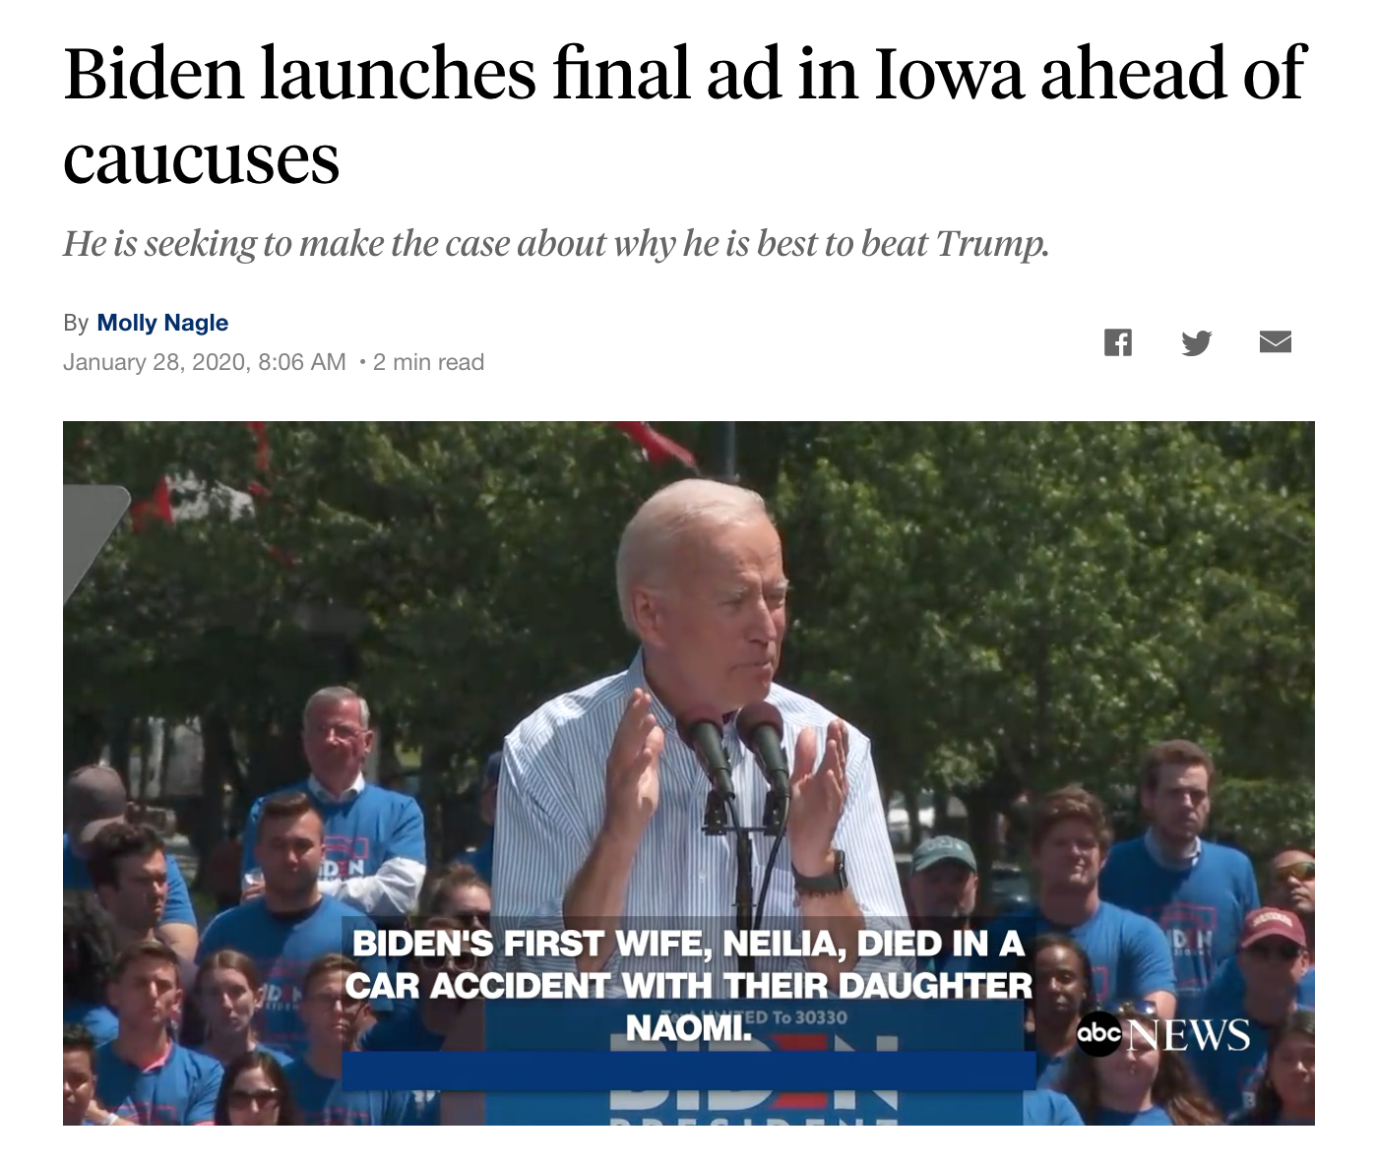
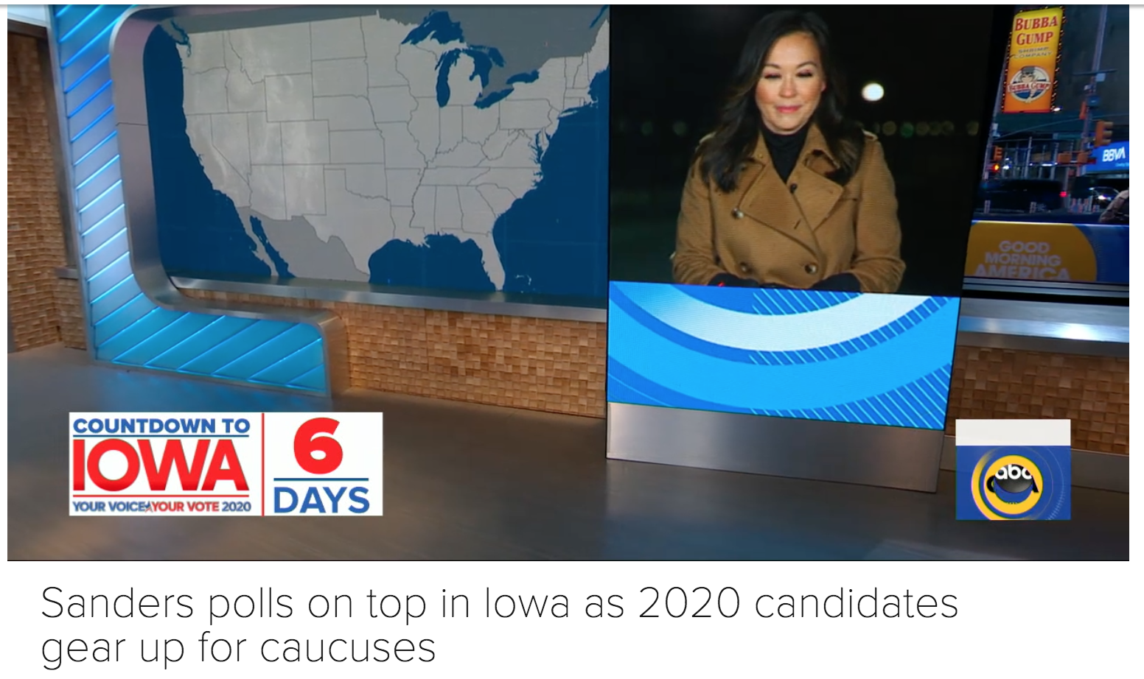
E L E C T R I C
Biden launches final ad in Iowa ahead of caucuses
Molly Nagle – January 28, 2020
In a last ditch effort to gain the lead in the democratic caucus, Biden focuses his campaign on being the most capable of beating Trump.
Sanders polls on top in Iowa as 2020 candidates gear up for caucuses
Video Coverage – January 28,2020
Sen. Bernie Sanders rose in a New York Times poll that showed him on top with 25% of voters in Iowa as candidates Pete Buttigieg and Joe Biden trail with 18% and 17% respectively.
All caught up!

Slide 6
E L E C T R I C
The Green New Deal
Proposed by Rep. Alexandria Ocasio-Cortez and Sen. Ed Markey
Achieving a drastic reduction in emissions via a 10 year mobilization plan which includes a complete conversion to renewable energy, digitizing the power grid, upgrading to energy efficient buildings, and overhauling public transportation. The resolution emphasizes the duty of the government to provide training and economic development to communities who rely on fossil fuel industries.
Pro
Con
Mobilizing new economic development, combatting climate change.
Potential harmful effects to big energy and reducing U.S. presence as an energy resource.

